Slide 1
CSE-105:
PROGRAMMING FUNDAMENTALS
LECTURE 2: BASICS OF C
COURSE INSTRUCTOR: MD. SHAMSUJJOHA
Notes:
printf Background
The printf function is not part of the C language, because there is no input or output defined in C language itself. The printf function is just a useful function from the standard library of functions that are accessible by C programs. The behavior of printf is defined in the ANSI standard. If the compiler that you’re using conforms to this standard then all the features and properties should be available to you.

Slide 2
What is Computer?
Computer
  Device capable of performing computations and making logical decisions
  Computers process data under the control of sets of instructions called computer programs
Hardware
  Various devices comprising a computer
  Keyboard, screen, mouse, disks, memory, CD-ROM, and processing units
Software
  Programs that run on a computer

Slide 3
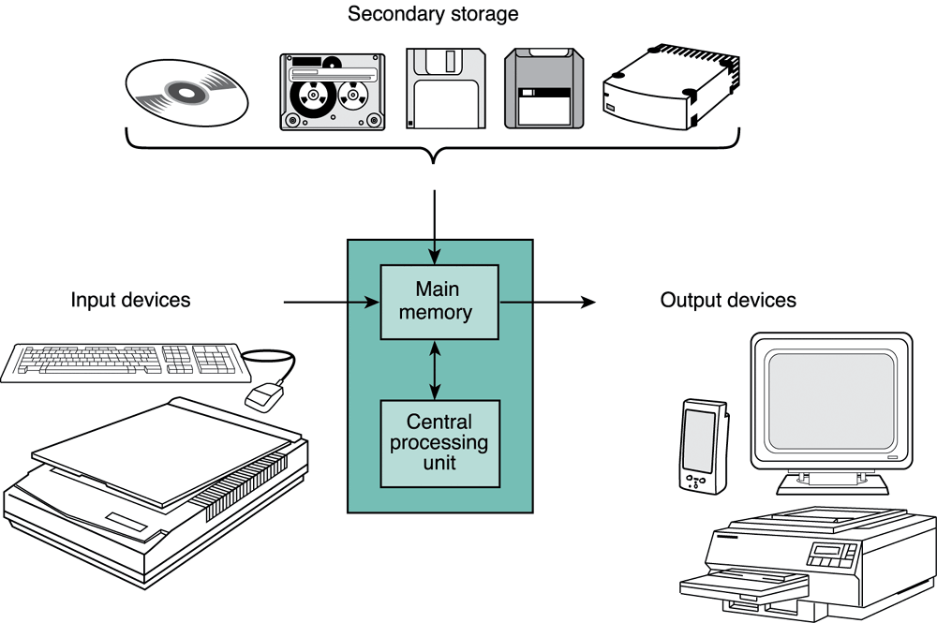
Computer Organization
Six logical units of computer
Components of a PC

Slide 4
Computer Organization
Six logical units of computer
  Input unit
    Accepts information from the user and transforms it to digital codes that the computer can process → Receiving section:
    Obtains information from input devices such as Keyboard, mouse, microphone, Scanner …
  Output unit
    An interface by which the computer conveys the output to the user → “Shipping” section
    Takes information processed by computer, Places information on output devices Screen, printer, networks, …
      Information used to control other devices

Slide 5
Computer Organization
Six logical units of computer
  Memory unit
    A semiconductor device which stores the information necessary for a program to run.
    2 types
      ROM (Read Only Memory)
        Contains information that is necessary for the computer to boot up
        The information stays there permanently even when the computer is turned off.
      RAM (Random Access Memory)
        Contains instruction or data needed for a program to run
        Got erased when the computer is turned off.

Slide 6
Computer Organization
Six logical units of computer
  Central processing unit (CPU)
      Does most of the work in executing a program
      The CPU inside a PC is usually the microprocessor consists of 3 main parts:
      Control Unit
        Fetch instructions from main memory and put them in the instruction register (Also called Forth logic unit of a Computer)
      ALU (Arithmetic Logic Unit)
        Execute arithmetic operations (Also called Fifth logic unit of a Computer)

Slide 7
Computer Organization
Six logical units of computer
  6. Secondary storage unit
    Long-term, high-capacity “warehouse” section
    Storage
      Inactive programs or data
    Secondary storage devices
      Disks
    Longer to access than primary memory
    Less expensive per unit than primary memory

Slide 8
The von Neumann architecture
CPU
Input Device
Output Device
ALU
CU
Main memory
(RAM)
Secondary
storage

Slide 9
How it works
How does a computer execute a program ? (example programs: a computer game, a word processor, etc)
  The instructions that comprise the program are copied from the permanent secondary memory into the main memory
  After the instructions are loaded, the CPU starts executing the program.
  For each instruction, the instruction is retrieved from memory, decoded to figure out what it represents, and the appropriate action carried out. (the fetch execute cycle)
  Then the next instruction is fetched, decoded and executed.

Slide 10
Machine Languages, Assembly Languages, and High-level Languages
Three types of computer languages
  Machine language
    Only language computer directly understands
    “Natural language” of computer
    Defined by hardware design
      Machine-dependent
    Generally consist of strings of numbers
      Ultimately 0s and 1s
    Instruct computers to perform elementary operations
      One at a time
    Cumbersome for humans
    Example:
      +1300042774
      +1400593419
      +1200274027

Slide 11
Machine Languages, Assembly Languages, and High-level Languages
Three types of computer languages
  Assembly language
    English-like abbreviations representing elementary computer operations
    Clearer to humans
    Incomprehensible to computers
      Translator programs (assemblers)
        Convert to machine language
    Example:
      LOAD BASEPAY
      ADD OVERPAY
      STORE GROSSPAY

Slide 12
Machine Languages, Assembly Languages, and High-level Languages
Three types of computer languages
  High-level languages
    Similar to everyday English, use common mathematical notations
    Single statements accomplish substantial tasks
      Assembly language requires many instructions to accomplish simple tasks
    Translator programs (compilers)
      Convert to machine language
    Interpreter programs
      Directly execute high-level language programs
    Example:
      grossPay = basePay + overTimePay

Slide 13

C History
Developed between 1969 and 1973 along with Unix
Due mostly to Dennis Ritchie
Designed for systems programming
  Operating systems
  Utility programs
  Compilers
  Filters

Slide 14
C Programming Environment
Preprocess/
Compile/
Link
Load/
Run
Edit
Editor
test.c
test.exe
CPU

Slide 15
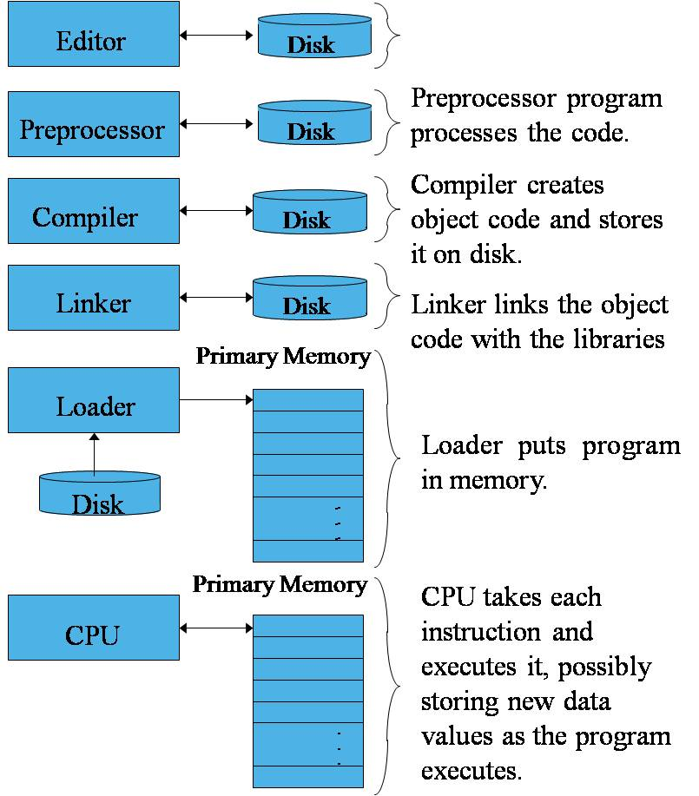
C Programming Environment
Phases of C Programs:
  Edit
  Preprocess
  Compile
  Link
  Load
  Execute

Slide 16
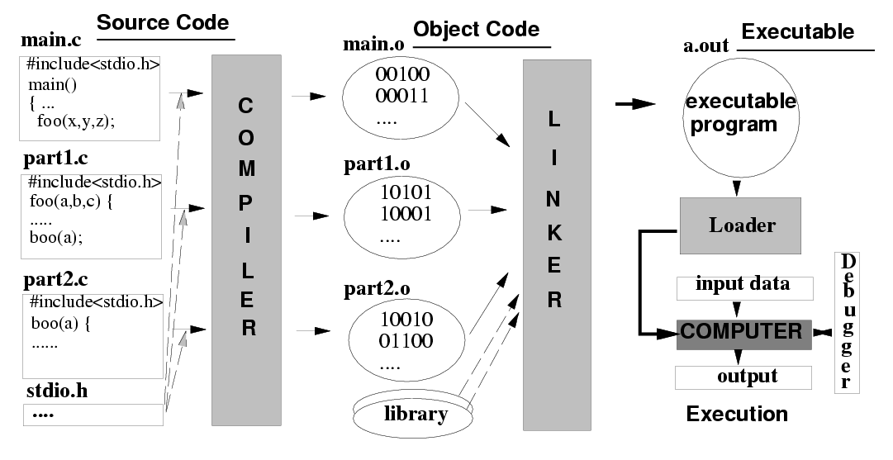
C Compilers, Linkers, Loaders

Slide 17
Some Key Terms
Source Program
  printable/Readable Program file
Object Program
  nonprintable machine readable file
Executable Program
  nonprintable executable code
Syntax errors
  reported by the compiler
Linker errors
  reported by the linker
Execution/Run-time errors
  reported by the operating system

Slide 18
A Simple Program in C - exp
#include <stdio.h>
standard Library, input-output, header-file
Begin of program
int main ()
{
}
Start of Segment
Function for printing text
printf(“This is Our First C Programme\n”) ;
Insert a new line
End of Segment
End of statement
Output : This is Our First C Programme

Slide 19
A Simple Program in C - exp
#include <stdio.h>
int main ()
{
}
printf(“This is Our First C\n Programme”) ;
Output : This is Our First C
Programme

Slide 20
A Simple Program in C - exp
#include <stdio.h>
int main ()
{
}
printf(“This \n is Our First C\n Programme”) ;
Output : This
is Our First C
Programme

Slide 21
A Simple Program in C - exp
#include <stdio.h>
int main ()
{
}
printf(“This \n is Our First C\n Programme”) ;
printf(“PROGRAMME”) ;
Output : This
is Our First C
ProgrammePROGRAMME

Slide 22
A Simple Program in C - exp
#include <stdio.h>
int main ()
{
}
printf(“This \n is Our First C\n Programme ”) ;
printf(“PROGRAMME”) ;
Output : This
is Our First C
Programme PROGRAMME

Slide 23
A Simple Program in C - exp
#include <stdio.h>
int main ()
{
}
printf(“This \n is Our First C\n Programme ”) ;
printf(“ PROGRAMME”) ;
Output : This
is Our First C
Programme PROGRAMME

Slide 24
A Simple Program in C - exp
#include <stdio.h>
int main ()
{
}
printf(“This \n is Our First C\n Programme ”) ;
printf(“\nPROGRAMME”) ;
Output : This
is Our First C
Programme
PROGRAMME

Slide 25
A Simple Program in C - exp
#include <stdio.h>
int main ()
{
}
printf(“This \n is Our First C\n Programme\n ”) ;
printf(“PROGRAMME”) ;
Output : This
is Our First C
Programme
PROGRAMME

Slide 26
A Simple Program in C - exp
#include <stdio.h>
int main ()
{
}
printf(“T\nh\ni\ns is Our First C Programme ”) ;
printf(“T\nh\ni\ns is Our First C Programme ”) ;
Output : T
h
i
s is Our First C Programme

Slide 27
Summary
We have looked at some underlying hardware
We have seen some different types of languages;
  the relevance of semantics and syntax.
We have observed the detail necessary in an imperative language to instruct a computer properly.
Finally, we examined the syntax to print a line of text to the screen of our computer.

Slide 28

Questions or Suggestions

Slide 29

THANK YOU!

